Slide 1
Detecting contextual hate speech code words within social media
Jherez Taylor and Prof. Yi-Shin Chen Co-Advisor: Prof. Chaur-Chin Chen
National Tsing Hua University
Institute of Information Systems and Applications

Slide 2
Background
Hate Speech is “any advocacy of national, racial or religious hatred that constitutes incitement to discrimination, hostility or violence”
Why should we understand hate speech?
Physical consequences for affected groups.
Conditioning people to hate can be disastrous. [1930s Germany]
Loss of business revenue.
Why is Hate Speech difficult to analyse?
Hard to identify.
Subjective perceptions of word usage.
Frequent introduction of new terms.
Notes:
Cases where people have killed themselves or been physically attacked because of hate speech.
German society didn’t change overnight. People were trained to hate the jews over time.

Slide 3
Motivation
Anyone who isn’t white doesn’t deserve to live here. Those foreign ________ should be deported.
animals
skypes
niggers
Use of inoffesive keyword. Can infer the intent.
This is weird. Isn’t Skype a company?
Use of known hate speech keyword. Easy to catch.
Code words act like Morse code
for extremist groups.
Notes:
We need to find out what they are saying.

Slide 4
Challenges
Code Word: “a word or phrase that has a secret meaning or that is used instead of another word or phrase to avoid speaking directly” Merriam-Webster
Code words are used infrequently but constantly introduced.
The context determines the hate speech meaning of a word.
Difficult to understand using a fixed dictionary, dynamic vocabulary.
Notes:
Saying “I hope she skypes me”
is a very different context from
“those skypes should be deported”

Slide 5
Objective
Dynamically identify out-of-dictionary hate speech code words
Consider word usage based on different corpora.
Use hate speech word neighbours to expand the dictionary.
Through the context of word similarity and relatedness.

Slide 6
Related Work
Stereotypes and Othering Language (“Us vs Them”)
“Detecting hate speech on the world wide web” [Warner and Hirschberg 2012]
“Us and them: identifying cyber hate on Twitter” [Burnap and Williams 2016]
Need for annotation of paragraphs stereotypes.
Us vs Them terms are mostly event specific.
Code word classification
“Detecting the Hate Code on Social Media” [R. Magu et al., 2017]
Used a static list of code words, unable to identify new ones.
Neural Embedding models
“Hate Speech Detection with Comment Embeddings” [Djuric, N. et al., 2015]
“Abusive Language Detection in Online User Content” [C. Nobata. et al, 2016]
Not fit for low frequency words.
Notes:
Each word has a stereotype that can be use for classification.
Send them home.
Map comments to vector space. Predict words based on comment.

Slide 7
Methodology

Slide 8
The importance of data partitioning
There are communities of users that share hateful content
Primary source for new code words.
We assume code words here have a higher document frequency.
HateWords = {hw₁,hw₂,...,hw_{n}} where hw_{n} refers to a known hate speech word
Obtained from the HateBase Organisation
Create partitions
HateCommunity: articles and the tweets of users in the authour network.
CleanTexts: tweets collected without terms, filtering against HateWords.
Partition the data to reflect word usage under contexts.
Notes:
A good place to start the search.
Consists of website articles and titles, and tweets scrapped from the list provided by the SPLC.

Slide 9
What is word context?
Distributional hypothesis: words that appear in the same contexts share semantic meaning [Z.S. Harris, 1954]
Context modeling can allow us to find neighbouring hate speech words.
Relatedness: word collocation
the
man
jumps
Similarity: behaviour
boy
plays
talks
Notes:
Find code words.
Two types of context.
Treat words as neighbours.
Frequently appear together
Behave like each other

Slide 10
Learning Context with Neural Embeddings
Map words to vector space.
Learn relatedness with word2vec
Predict words that often appear together with a target word w.
Context: w and the surrounding words in a given window.
[Mikolov et al. 2016]
Learn similarity with a variation of word2vec called dependency2vec
Context: syntactic dependencies in a sentence.
SD describe the structure of a sentence.
[Levy and Goldberg ACL ’14]
Notes:
Allows for cosine similarity measures.

Slide 11
Why does word context matter?
The presence of hate speech keywords under skypes is surprising.
Create different embeddings to capture different word usage.
Build similarity and relatedness embeddings for HateCommunity and CleanTexts.
skypes
skyped facetime Skype-ing phone | whatsapp line snapchat imessage
chat dropbox kike Line | cockroaches negroes facebook animals
CleanTexts
HateCommunity
Relatedness
Similarity
Notes:
Results are ranked by cosine similarity
We build a model using similarity and relatedness to identify code words.

Slide 12
Intuition
Use word frequency in our datasets as well as context to find code words.
high frequency in hate speech data + hate speech neighbours = possible code word
Generate an initial list of words similar to HateWords.
Impractical to do an exhaustive search of the vocabulary.
Need a way to generate neighbouring words as input.
We can use PageRank.

Slide 13
Finding word neighbours with PageRank
faggots
niggers
negroe
1
1
1
1
animals
1
niggers: 0.097
faggots: 0.1505
cunts: 0.1505
monkeys: 0.1505
negroe: 0.1505
asshole: 0.1505
animals: 0.1505
1
cunts
1
asshole
monkeys
Repeat process for leaf vertices.
Directed graph based on word similarity from HateCommunity
HateWords are seed vertices
All edges have the same weight.
If we run PageRank all vertices would have the same value.
Notes:
PageRank is a means of identifying important links in a graph.

Slide 14

Finding word neighbours with PageRank
Give hate speech words a higher importance.
Generate initial output for all words in HateWords as list
boost
Stored counts for each word
count(nigger) = 10000
boost(nigger) = 10
cosineSim(nigger, faggots) = 0.92
count(animals) = 2000
boost(animals) = 0
cosineSim(animals, monkeys) = 0.67
$$wt\left(nigger,faggots\right)=\log\left(10000\right)∗10+0.92=40.92$$
$$wt(animals, monkeys)=0.67$$
$$wt\left(v_{1}v_{2}\right)= \left\{\begin{aligned}\log\left(freq\left(v_{1}\right)\right)∗boost\left(v_{1}\right)+cosineSim\left(v_{1},v_{2}\right)if v_{1}∈boost \\ cosineSim\left(v_{1},v_{2}\right)if v_{1} ∉boost\end{aligned}\right.$$
Notes:
Returns an initial list of hate speech neighbours.

Slide 15
Finding word neighbours with PageRank
faggots
niggers
negroe
33.63
40.92
0.81
0.72
animals
40.89
niggers: 0.097
faggots: 0.132
cunts: 0.176
monkeys: 0.0753
negroe: 0.251
asshole: 0.215
animals: 0.0753
cunts
25.71
0.67
asshole
monkeys
By doing this, known hate speech words
pass on their weight
Allows us to find important neighbours of hate speech words

Slide 16
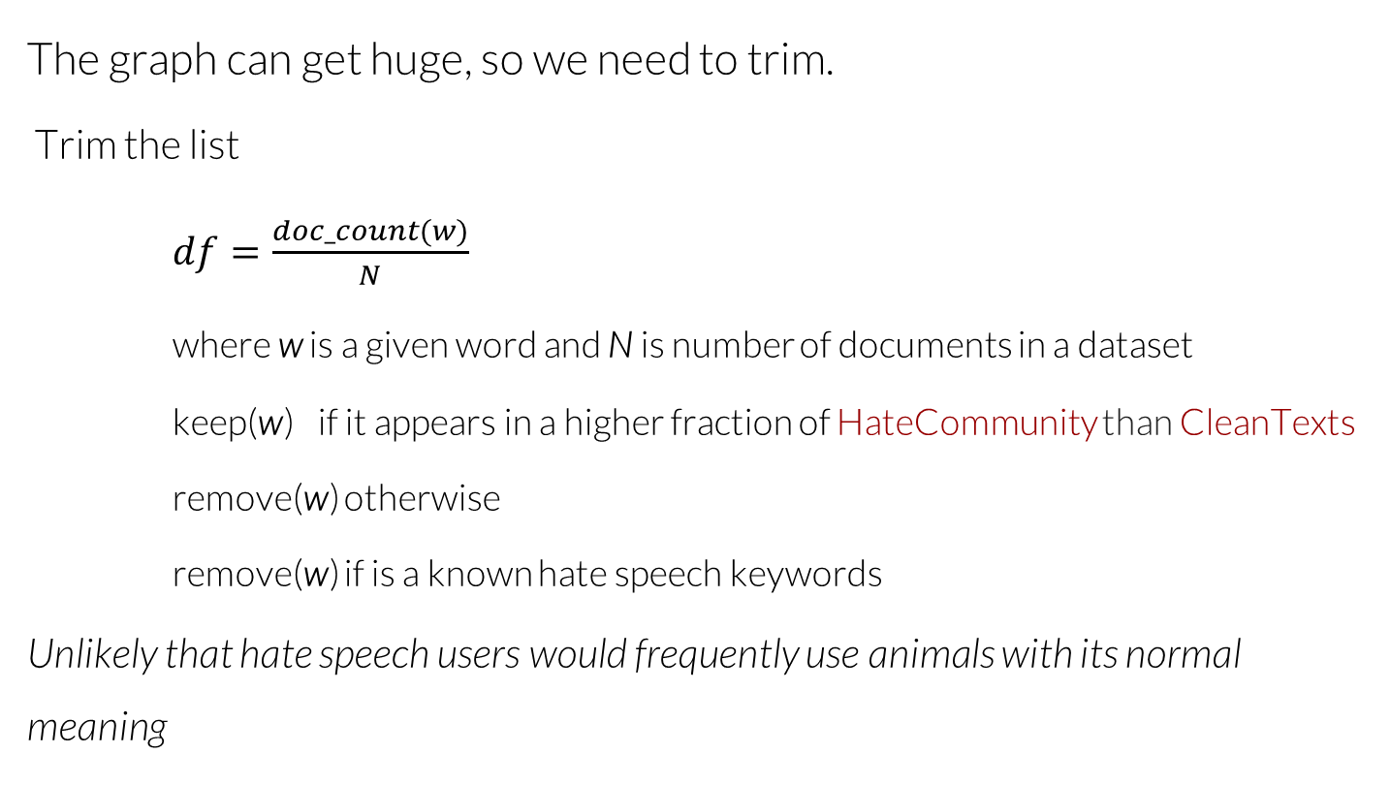
Trimming word neighbours
The graph can get huge, so we need to trim.
Trim the list
$df=\frac{doc_count(w)}{N}$
where w is a given word and N is number of documents in a dataset
keep(w) if it appears in a higher fraction of HateCommunity than CleanTexts
remove(w) otherwise
remove(w) if is a known hate speech keywords
Unlikely that hate speech users would frequently use animals with its normal meaning
Notes:
General population of online text
If w is a code word then it is likely to have a $df$ in HaeTexts

Slide 17
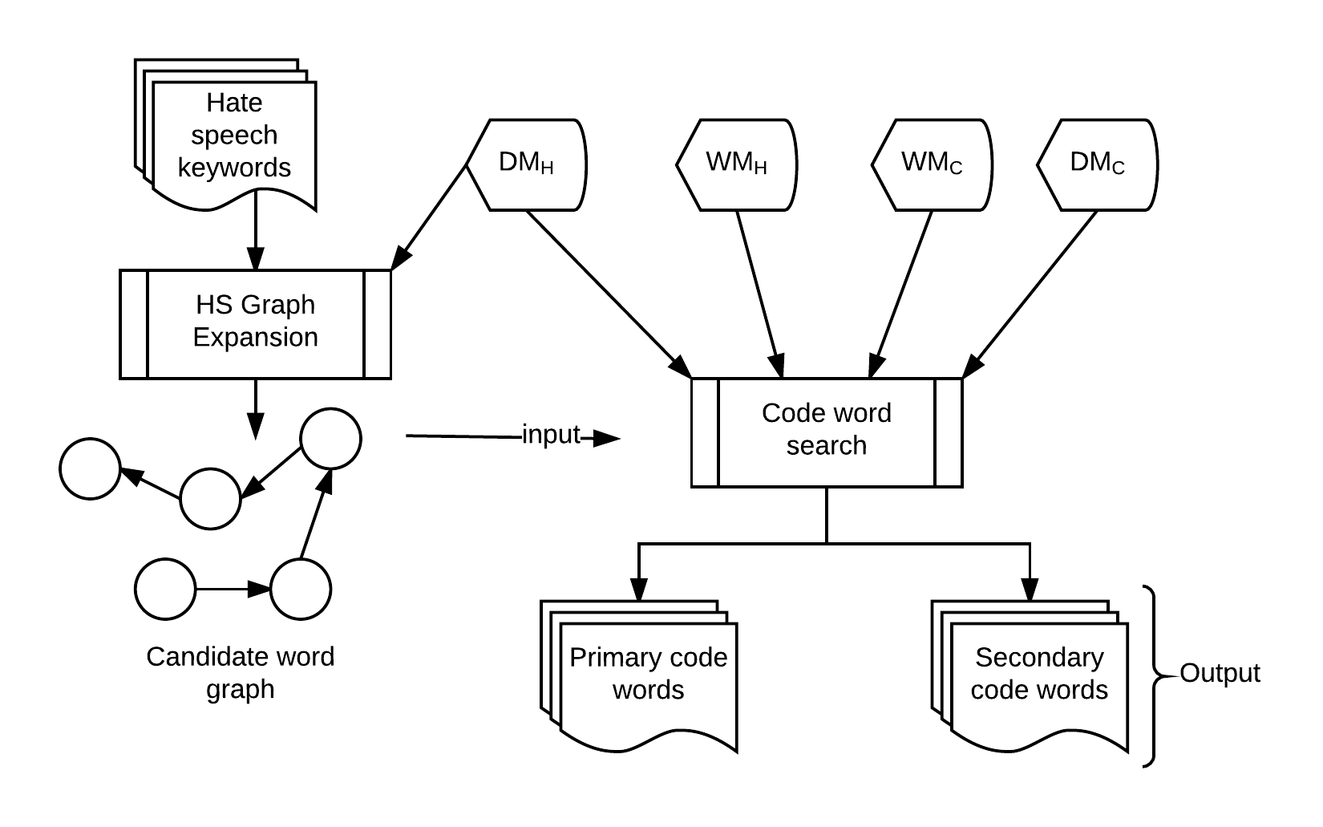
Code word ranking
Notes:
Refresher
Define primary and secondary

Slide 18
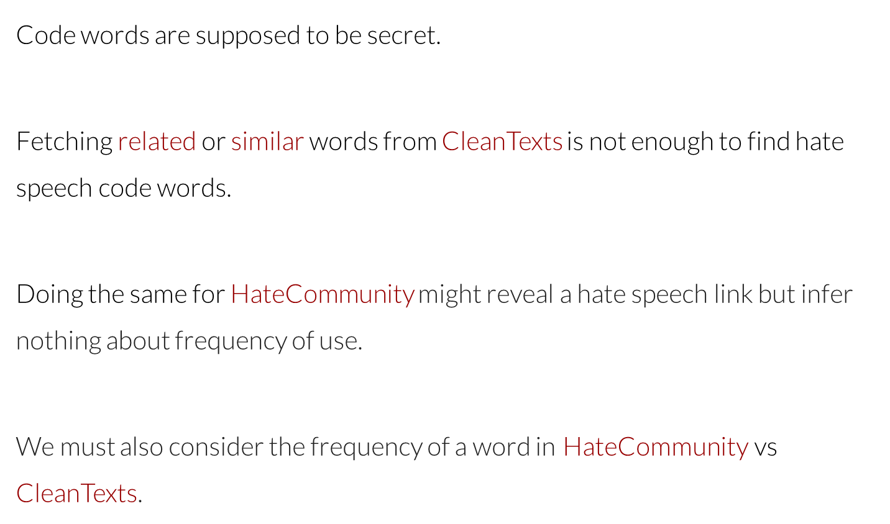
Code word ranking
Code words are supposed to be secret.
Fetching related or similar words from $\text{CleanTexts}$ is not enough to find hate speech code words.
Doing the same for $\text{HateCommunity}$ might reveal a hate speech link but infer nothing about frequency of use.
We must also consider the frequency of a word in HateCommunity vs $\text{CleanTexts}$.

Slide 19
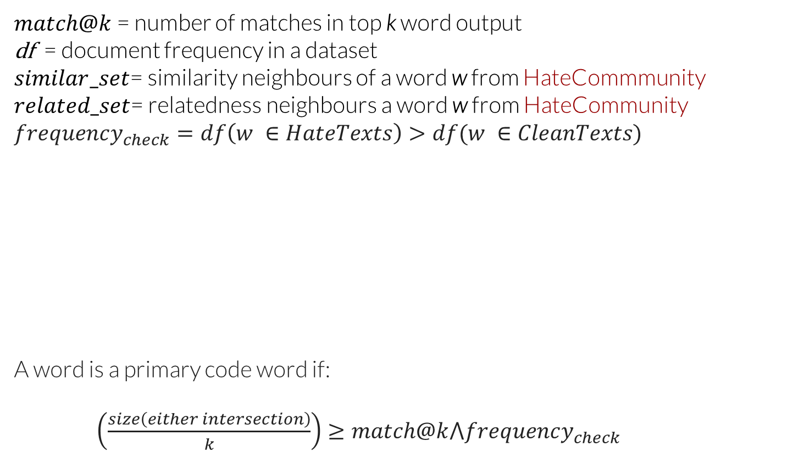
Code word ranking
$match@k$= number of matches in top k word output
df = document frequency in a dataset
$similar_set$= similarity neighbours of a word w from HateCommmunity
$related_set$= relatedness neighbours a word w from HateCommunity
$$frequency_{check}=df\left(w ∈HateTexts\right)>df(w ∈CleanTexts)$$
A word is a primary code word if:
$\left(\frac{size\left(either intersection\right)}{k}\right)≥match@k⋀frequency_{check}$
HateWords
SimilarSet
HateWords
RelatedSet
Notes:
We call this primary as we believe they are words that are close to known hate speech words

Slide 20

Code word ranking: Secondary
We implement a secondary condition for words that fail Primary
With a word w build a similarity graph $G$ as previously described
A word w is a secondary code word if for any $v∈G$
$v ∈HW$
Notes:
These are words we believe are linked to hate speech but not as close.

Slide 21
Evaluation

Slide 22
Data Collection
Twitter data was collected during the
2016 US Presidential Elections
2017 US Presidential Inauguration
2017 Manchester bombing
Various points in 2017
CleanTexts and HateTexts: 10M tweets
HateCommunity: 400K tweets and articles

Slide 23
Evaluation Setup
55 Primary code words
262 Secondary code words
Designed an experiment to see if annotators could infer the use of hate speech with only code words
5 samples for each word
Ratings from Very unlikely to very likely [0 to 4]
3 separate experiments from different partitions
> 45 annotators for each experiment
Code words
niggers [positive control]
snake
googles
cuckservatives
skypes
creatures
moslems
cockroaches
water [negative control]
primitives
Another cop killed and set on fire by googles
Strange mixed breed creatures jailed for killing white woman
Germany must disinfect her land. One cockroach at a time
Notes:
Primary: cuckservatives, primitives, niggers
Experiment: can people identify text as HS w/o the presence of known HS words and w/o knowing the meaning of the CW.
Can they identify based on the samples alone.

Slide 24
Evaluation: Control results
Most participants were able to correctly answer the control across all 3 experiments

Slide 25
Evaluation: Annotator Agreement
Created ground truth and aggregate majority annotator ratings
Ratings > 2 were labelled as Hate Speech
Ratings < 2 were labelled as Not Hate Speech
Krippendorff’s Alpha agreement scores using majority ratings
HateCommunity: K=0.871
CleanTexts: K = 0.676
HateTexts: K = 0.807

Slide 26
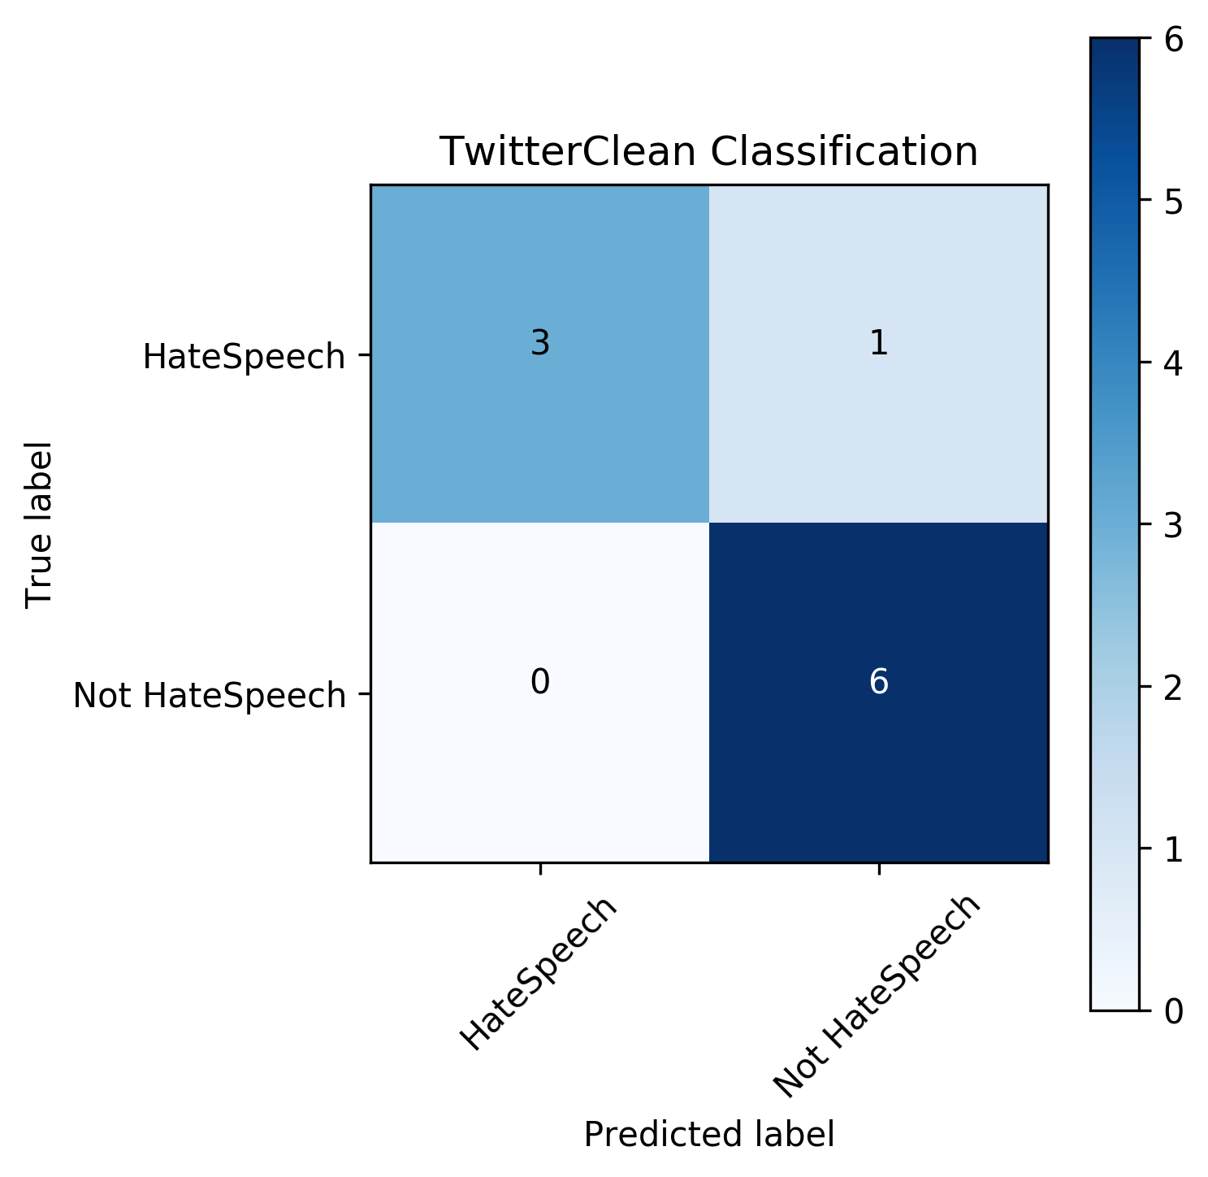
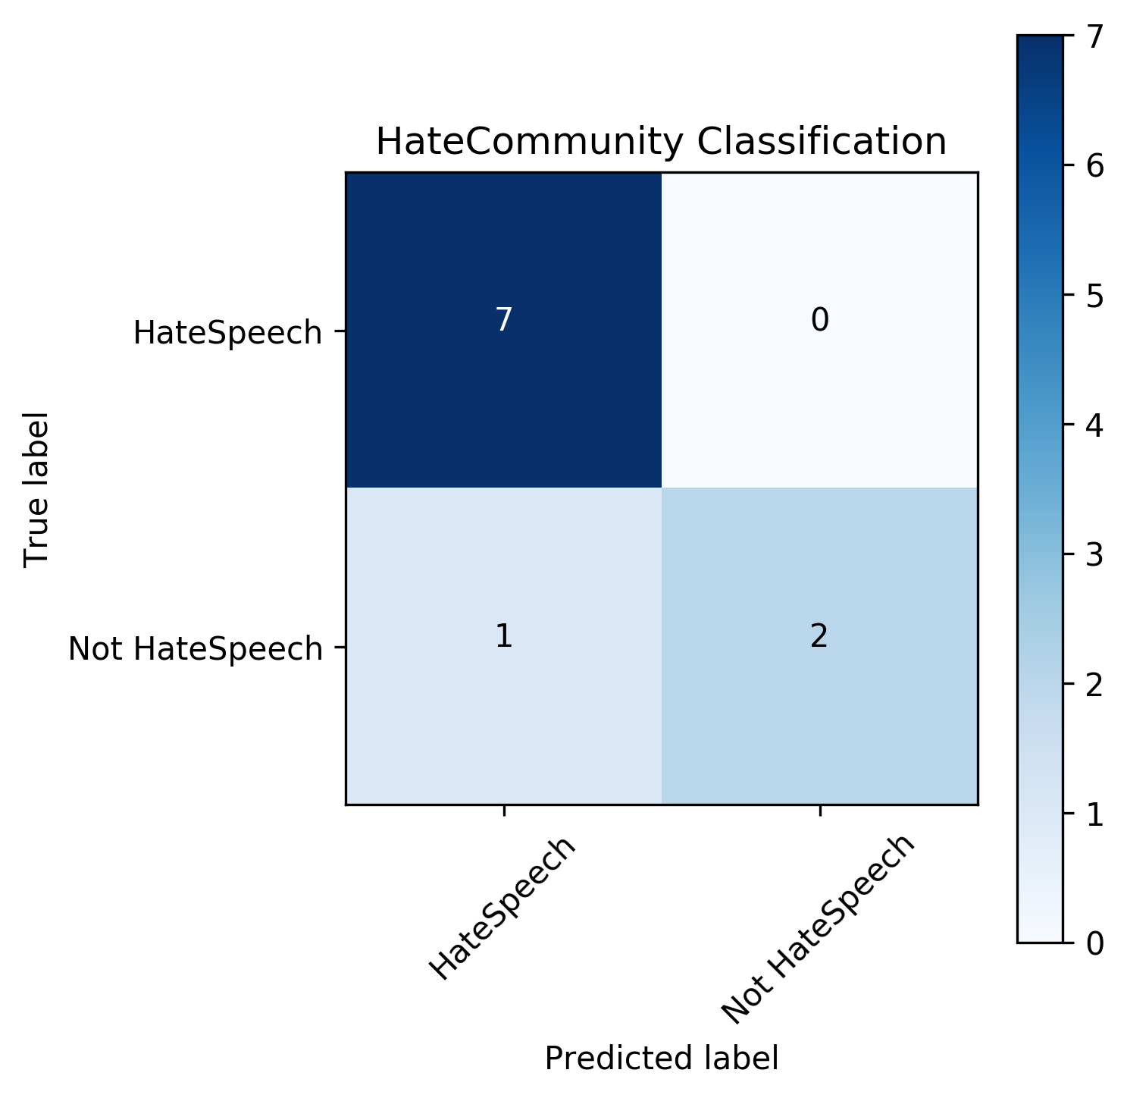
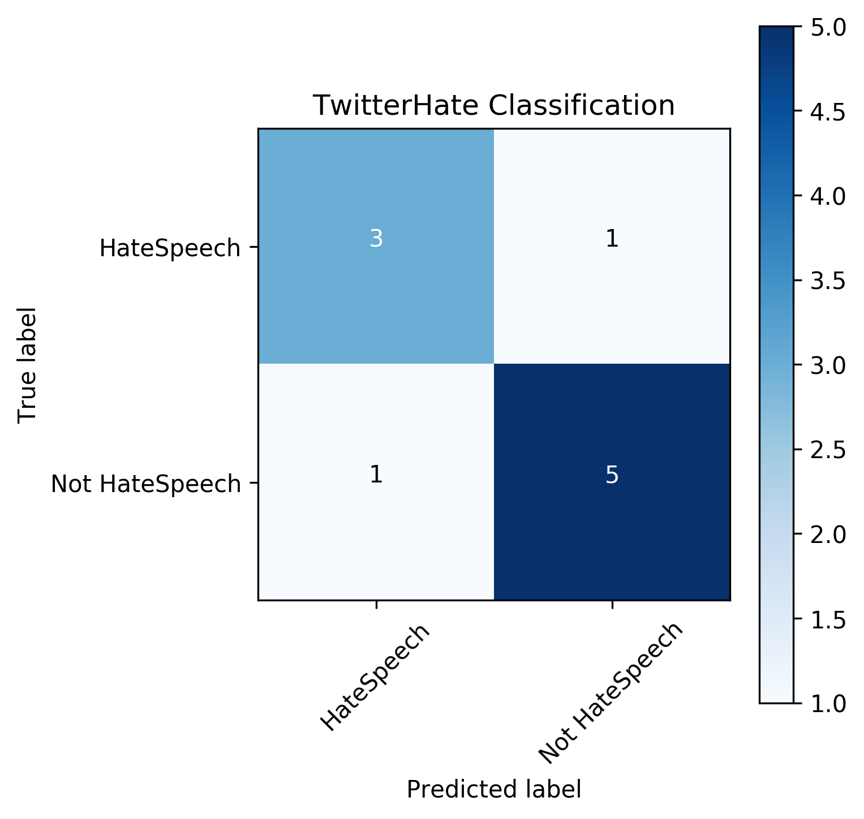
Evaluation: Aggregate Classification
Confusion Matrix
Notes:
Fix sizing

Slide 27
Evaluation: Aggregate Classification
 |  | Hate Speech | Not Hate Speech
HateCommunity | Precision Recall F1 | 0.88 1.00 0.93 | 1.00 0.67 0.80
CleanTexts | Precision Recall F1 | 1.00 0.75 0.86 | 0.86 1.00 0.92
HateTexts | Precision Recall F1 | 0.75 0.75 0.75 | 0.83 0.83 0.83
Notes:
Precision: number of selected items that are relevant
Recall: number of relevant items that are selected

Slide 28
Conclusions
We propose our dynamic method for learning out-of-dictionary hate speech code words.
Our annotation experiment showed that it is possible to infer hate speech without knowing the meaning of the code word.
Hate speech is not dependent on a vocabulary, it is an issue of context.
We hope to implement a method to automatically update our model.

Slide 29
Thank you. Q & A.

Slide 30
Evaluation: Ranking Distribution
HateCommunity Results
 | Ground Truth |  | Annotators
Words | Label | Majority percentage | Label | Majority percentage
Niggers | Very likely | 0.8 | Very likely | 0.68
Snakes | Unlikely | 0.4 | Neutral | 0.26
Googles | Very likely | 1.0 | Very likely | 0.41
Cuckservatives | Unlikely | 0.8 | Likely | 0.36
Skypes | Likely | 0.8 | Likely | 0.3
Creatures | Very likely | 0.6 | Very likely | 0.4
Moslems | Likely | 0.8 | Very likely | 0.39
Cockroaches | Very likely | 1.0 | Very likely | 0.40
Water | Very unlikely | 1.0 | Very unlikely | 0.65
Primitives | Very likely | 0.6 | Very likely | 0.37

